Slide 1

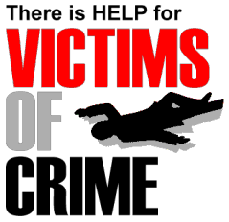
Victims’ Rights and Services
Crime Victims' Bill of Rights
A crime victim has the following rights: (1) The right to be reasonably protected from the accused. (2) The right to reasonable, accurate, and timely notice of any public court proceeding, or any parole proceeding, involving the crime or of any release or escape of the accused.
Protect victims of crime
Types of Victims
The highest rates of victims in Washington, D.C. include:
1. Aggravated assault ( 626)
2. Burglary (626)
3. Robbery (530)
4.. Forcible rape (53)
5 Homicide (18)
Crime Victims’ Compensation Program
This is a government program aimed at reimbursing the victims of crime as well as their families who are directed by the victims condition.
Compensation to victims of crime may include reasonable expenses such as: payment of any loss of wages or income up to $20,000
Violent crimes in Washington DC are three times higher than the National average.
In 2016, according to Uniform crime reporting collected by FBI, there were total of 1,244 violent crimes which include property and aggravated assault.
Contact Us
Phone: [(202) 879-4216
Email: ovsjg@dc.gov
Web: www.ovsjg.com

